Slide 1
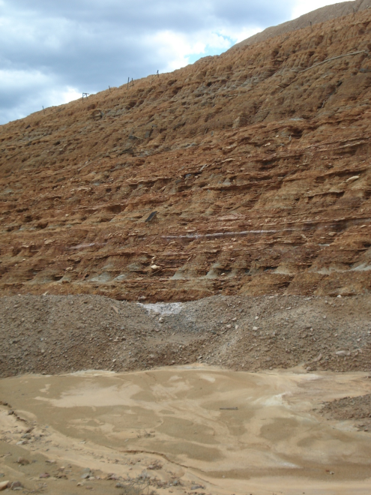
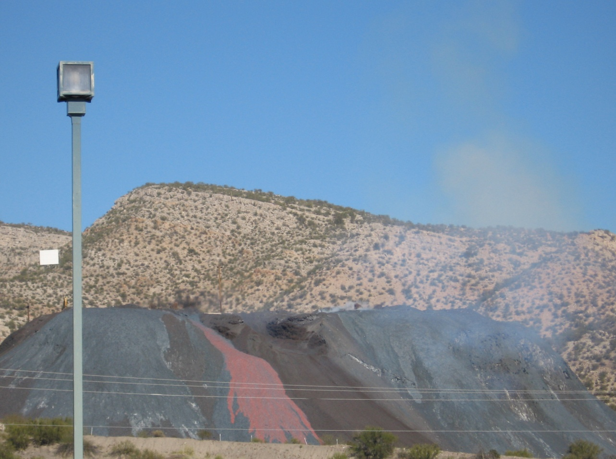


Characteristics of Wind-Blown Dust from Arizona Mining Operations
Presented by Paul Rheinheimer
A.E. Sáez, E.A. Betterton, J. Csavina, A. Wonaschutz, W. Conant, B. Barbaris, A. Landázuri, K. Rine, A. Campillo
Research Supported by NIEHS Superfund Research Program
NASA Space Grant Symposium, 2010

Slide 2
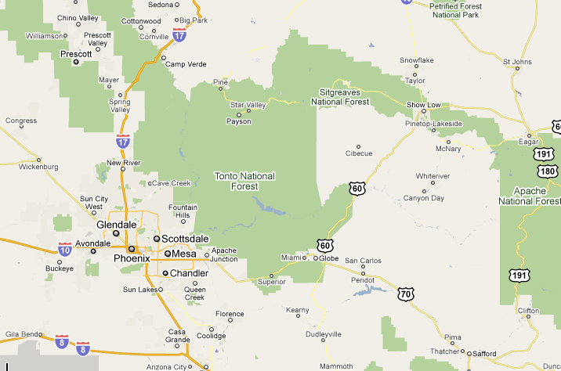
Sites in Focus
Iron King –
  Inactive mine
  Inactive smelter
Hayden –
  Active mine
  Smelter

Slide 3
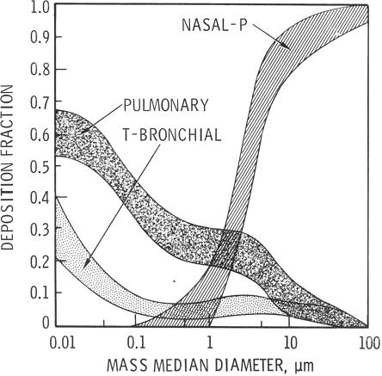
Particle sizes and respiratory effects
Three particle sizes:
  Coarse
    Mechanically
    generated
  Accumulation
  Fine
    Smelting
    operations

Slide 4
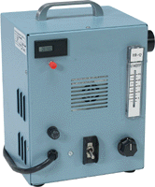
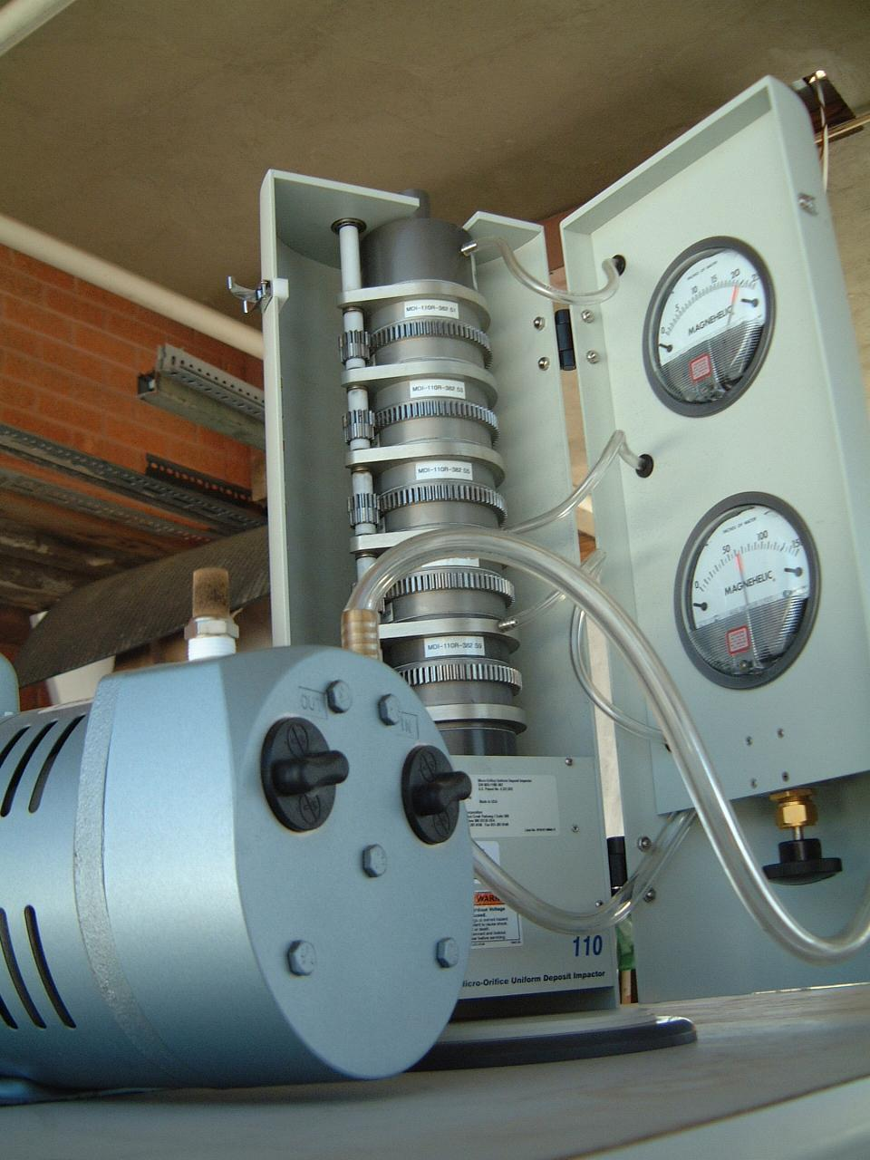
Equipment
Total Suspended Particles Sampler
  24 hour sampling time
  Measures PM10
MOUDI – Micro-Orifice Uniform-Deposit Impactor
  Multiple day sampling time
  Measures particles over a range of particle sizes
  (18 μm to 0.054 μm)

Slide 5
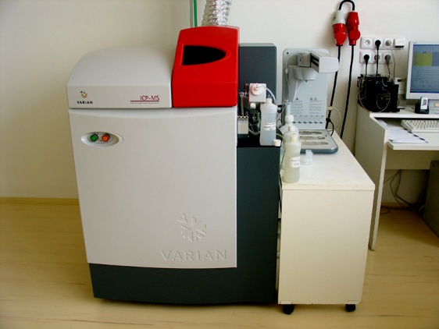
Particle Measurement Equipment
Ion Chromatography
  Measures concentrations of water soluble ions
  Cations: Na⁺, NH₃⁺, K⁺, Mg²⁺, Ca²⁺
  Anions: Acetate, Formate, Cl⁻, NO₃⁻, SO₄²⁻
Inductively Coupled Plasma – Mass Spectrometry
  Measures metal and metalloid concentrations
  Focus on Arsenic (As), Cadmium (Cd), and Lead (Pb)

Slide 6
Average concentration over the months of December, January, & February of 2009
AZ HAPS: (Chronic) guidance levels for Arsenic

Slide 7
Average concentration of heavy metals over an annual period (2009)
AZ HAPS: (Chronic) guidance levels for Arsenic

Slide 8
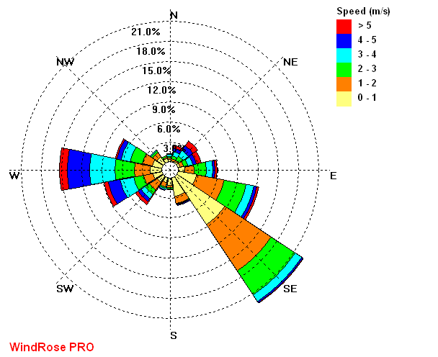
Annual Wind Speed & Direction:
Hayden-Winkleman Wind Rose
Smelter:
(Fine particles)
Mine tailings: (Coarse particles)

Slide 9
Conclusions & Future Work
Arsenic found in accumulation mode in concentrations above Arizona HAPS guideline
Lead also found in high concentrations in area
Solve issue of complex topography and its effect on modeling
Move MOUDI to new locations to assess new backgrounds and sources
Study effects metal concentrations have on local population

Slide 10
Thank You
Dr. Eric Betterton – Department of Atmospheric Sciences
NIEHS Superfund Research Program
Brian Barbaris – Department of Chemical & Environmental Engineering
Susan Brew – NASA Space Grant
Kyle Rine – Department of Physics

Slide 11
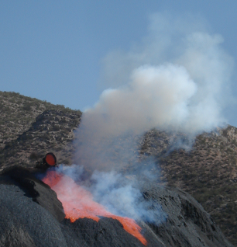
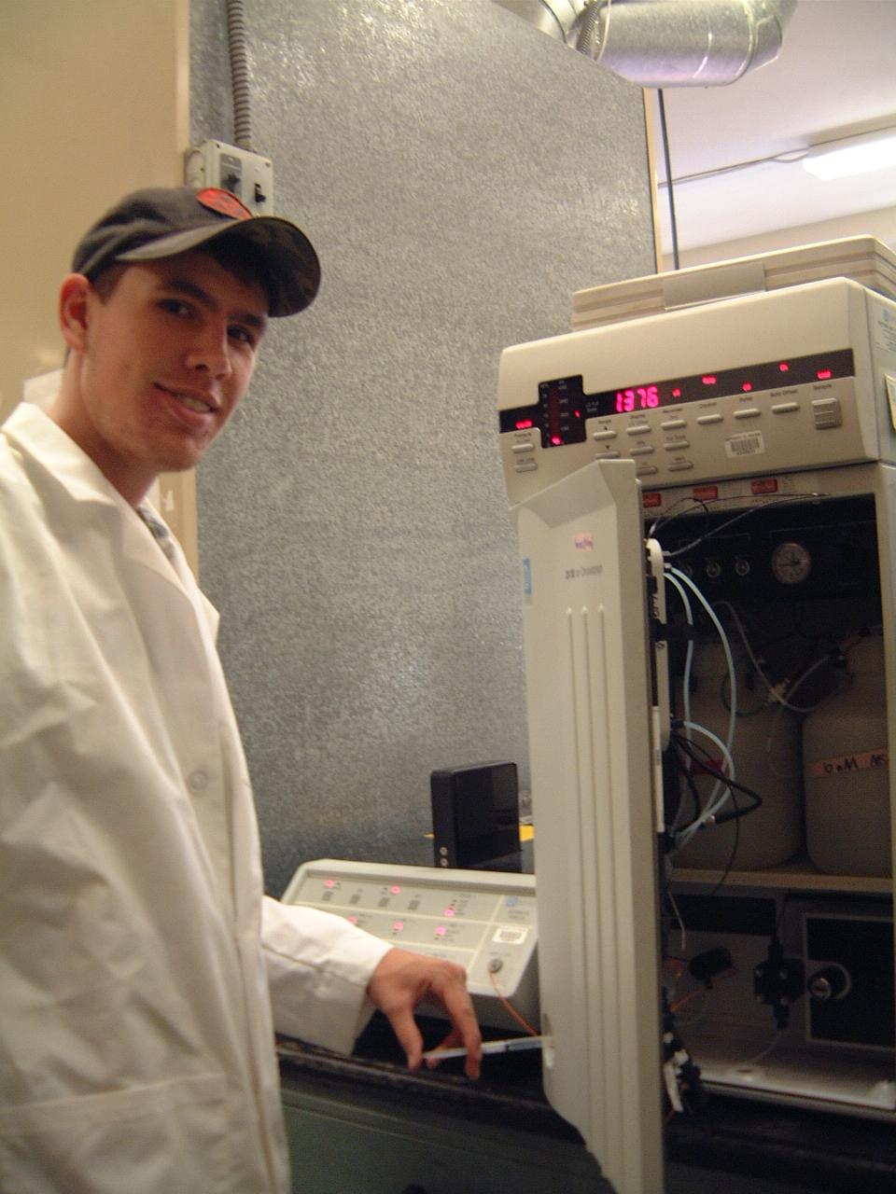
Questions?

